Slide 1
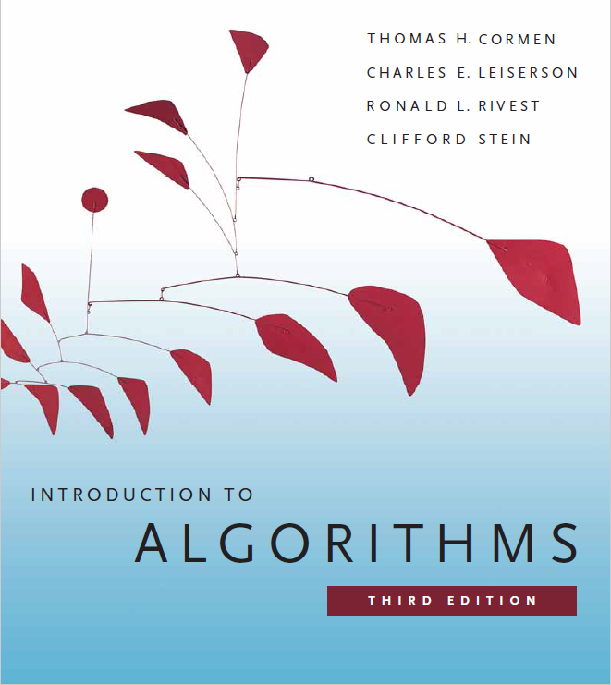
Amortized Analysis
Prepared by Shmuel Wimer
Courtesy of Prof. Dror Rawitz

Slide 2
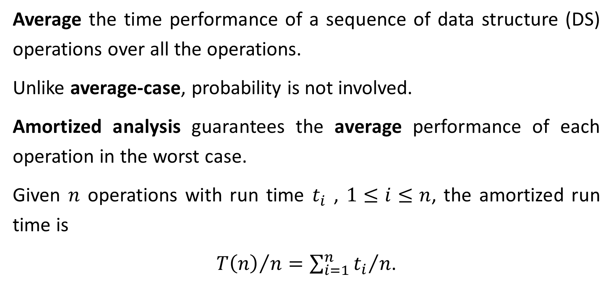
Amortized Analysis
Average the time performance of a sequence of data structure (DS) operations over all the operations.
Unlike average-case, probability is not involved.
Amortized analysis guarantees the average performance of each operation in the worst case.
Given $n$ operations with run time $t_{i}$ , $1≤i≤n$, the amortized run time is
${T\left(n\right)}/n={\sum_{i=1}^{n}{t_{i}}}/n$.

Slide 3
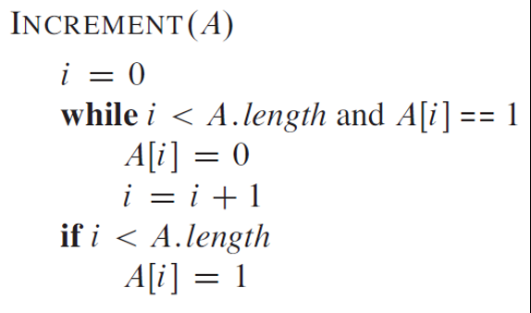
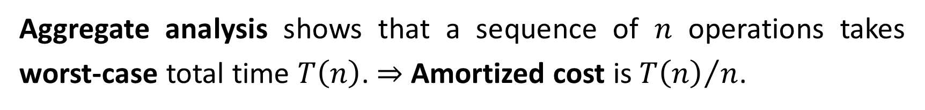
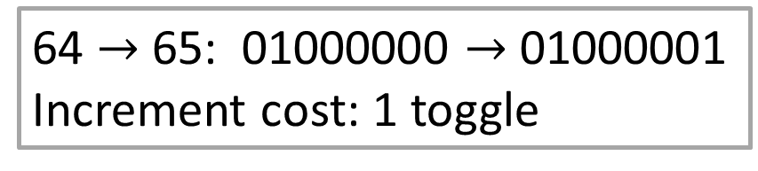

Aggregate Analysis
Aggregate analysis shows that a sequence of $n$ operations takes worst-case total time $T\left(n\right)$. ⇒ Amortized cost is ${T\left(n\right)}/n$.
Example: Binary counter increment
63 $→$64: 00111111 $→$ 01000000
Increment cost: 7 toggles
64 $→$65: 01000000 $→$ 01000001
Increment cost: 1 toggle

Slide 4
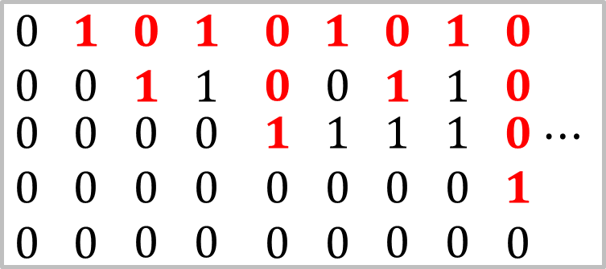
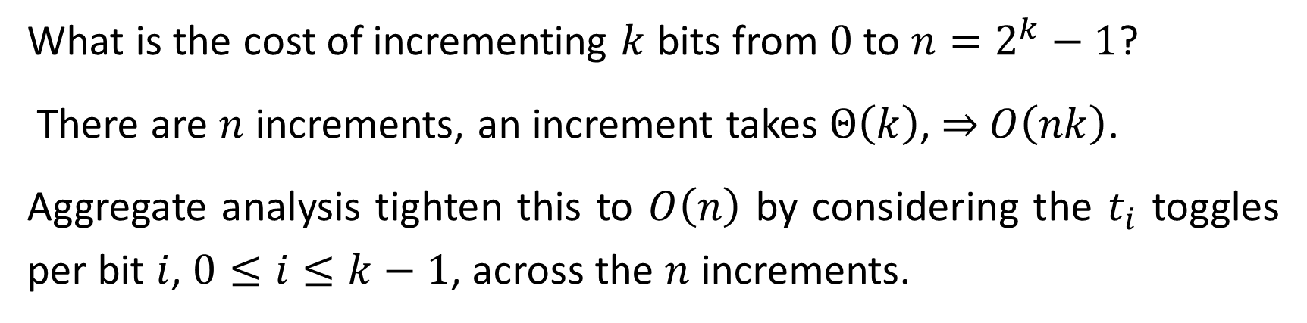
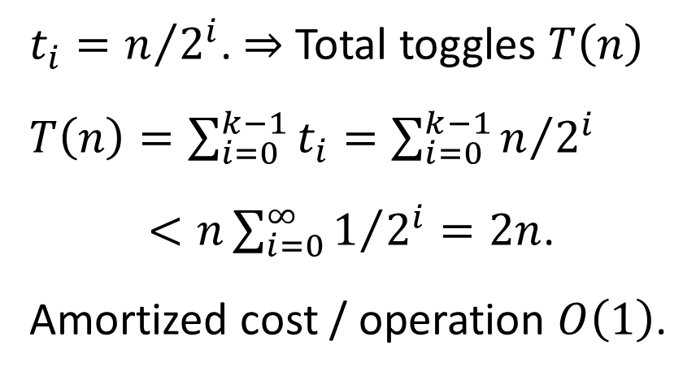

What is the cost of incrementing $k$ bits from $0$ to $n=2^{k}−1$?
There are $n$ increments, an increment takes $Θ\left(k\right)$, ⇒ $O\left(nk\right)$.
Aggregate analysis tighten this to $O\left(n\right)$ by considering the $t_{i}$ toggles per bit $i$, $0≤i≤k−1$, across the $n$ increments.
$t_{i}=n/{2^{i}}$. $⇒$ Total toggles $T\left(n\right)$
$T\left(n\right)=\sum_{i=0}^{k−1}{t_{i}}=\sum_{i=0}^{k−1}{n/{2^{i}}}$
$<n\sum_{i=0}^{∞}{1/{2^{i}}}=2n$.
Amortized cost / operation $O\left(1\right)$.
$$0 1 2 3 4 5 6 7 8 ⋯$$
$\begin{matrix}0 \\ 0 \\ \begin{matrix}0 \\ 0 \\ 0\end{matrix}\end{matrix}$ $\begin{matrix}1 \\ 0 \\ \begin{matrix}0 \\ 0 \\ 0\end{matrix}\end{matrix}$ $\begin{matrix}0 \\ 1 \\ \begin{matrix}0 \\ 0 \\ 0\end{matrix}\end{matrix}$ $\begin{matrix}1 \\ 1 \\ \begin{matrix}0 \\ 0 \\ 0\end{matrix}\end{matrix}$ $\begin{matrix}0 \\ 0 \\ \begin{matrix}1 \\ 0 \\ 0\end{matrix}\end{matrix}$ $\begin{matrix}1 \\ 0 \\ \begin{matrix}1 \\ 0 \\ 0\end{matrix}\end{matrix}$ $\begin{matrix}0 \\ 1 \\ \begin{matrix}1 \\ 0 \\ 0\end{matrix}\end{matrix}$ $\begin{matrix}1 \\ 1 \\ \begin{matrix}1 \\ 0 \\ 0\end{matrix}\end{matrix}$ $\begin{matrix}0 \\ 0 \\ \begin{matrix}0 \\ 1 \\ 0\end{matrix}\end{matrix}$ $⋯$

Slide 5
The Accounting Method
Assign different charges to different operations, some charged more or less than their actual cost.
When an operation’s amortized cost exceeds the actual cost, the difference yield credit, paid for later operations.
Thus, operation’s amortized cost is split between its actual cost and credit that is either deposited or used up.
This method differs from aggregate analysis, in which all operations have the same amortized cost.

Slide 6
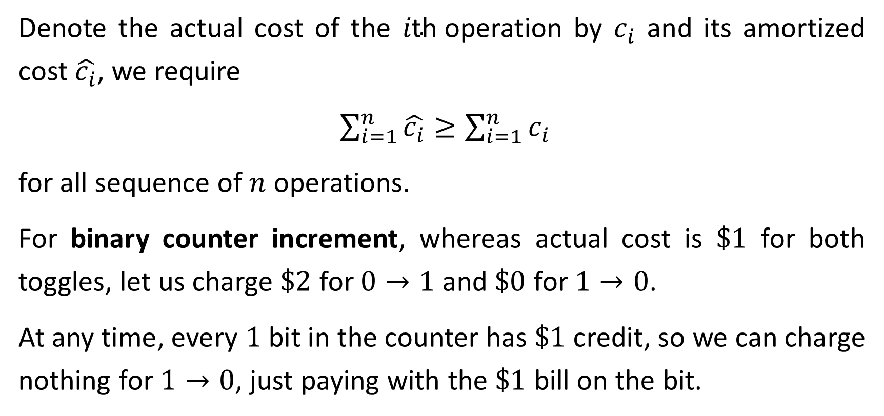
Denote the actual cost of the $i\text{th}$operation by $c_{i}$ and its amortized cost $\hat{c_{i}}$, we require
$\sum_{i=1}^{n}{\hat{c_{i}}}≥\sum_{i=1}^{n}{c_{i}}$
for all sequence of $n$ operations.
For binary counter increment, whereas actual cost is $\$1$ for both toggles, let us charge $\$2$ for $0→1$ and $\$0$ for $1→0$.
At any time, every $1$ bit in the counter has $\$1$ credit, so we can charge nothing for $1→0$, just paying with the $\$1$ bill on the bit.

Slide 7
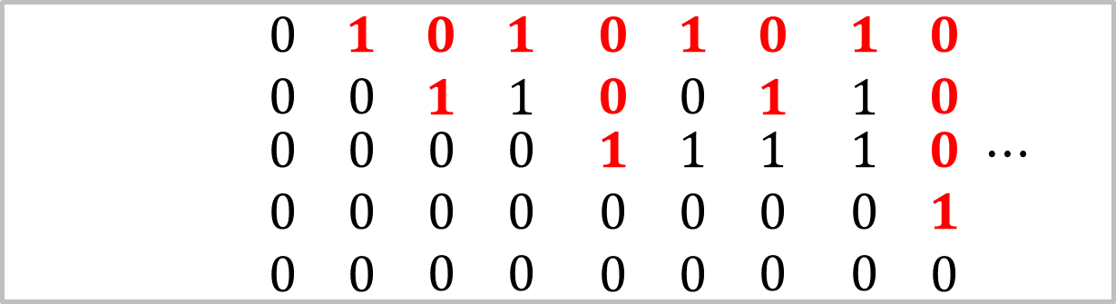
counter $0 1 2 3 4 5 6 7 8 ⋯$
$\begin{matrix}0 \\ 0 \\ \begin{matrix}0 \\ 0 \\ 0\end{matrix}\end{matrix}$ $\begin{matrix}1 \\ 0 \\ \begin{matrix}0 \\ 0 \\ 0\end{matrix}\end{matrix}$ $\begin{matrix}0 \\ 1 \\ \begin{matrix}0 \\ 0 \\ 0\end{matrix}\end{matrix}$ $\begin{matrix}1 \\ 1 \\ \begin{matrix}0 \\ 0 \\ 0\end{matrix}\end{matrix}$ $\begin{matrix}0 \\ 0 \\ \begin{matrix}1 \\ 0 \\ 0\end{matrix}\end{matrix}$ $\begin{matrix}1 \\ 0 \\ \begin{matrix}1 \\ 0 \\ 0\end{matrix}\end{matrix}$ $\begin{matrix}0 \\ 1 \\ \begin{matrix}1 \\ 0 \\ 0\end{matrix}\end{matrix}$ $\begin{matrix}1 \\ 1 \\ \begin{matrix}1 \\ 0 \\ 0\end{matrix}\end{matrix}$ $\begin{matrix}0 \\ 0 \\ \begin{matrix}0 \\ 1 \\ 0\end{matrix}\end{matrix}$ $⋯$
$\sum_{i=1}^{n}{\hat{c_{i}}} 0 2 4 6 8 10 12 14 16⋯$
$\sum_{i=1}^{n}{c_{i}} 0 1 3 4 7 8 10 11 15⋯$
credit $0 1 1 2 1 2 2 3 1 ⋯$

Slide 8
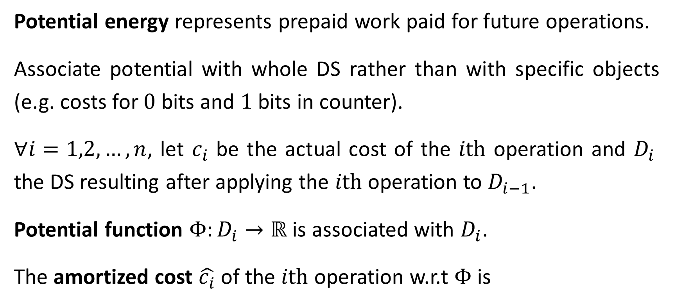
The Potential Method
Potential energy represents prepaid work paid for future operations.
Associate potential with whole DS rather than with specific objects (e.g. costs for $0$ bits and $1$ bits in counter).
$∀i=1,2,…,n$, let $c_{i}$ be the actual cost of the $i\text{th}$ operation and $D_{i}$ the DS resulting after applying the $i\text{th}$ operation to $D_{i−1}$.
Potential function $Φ:D_{i}→ℝ$ is associated with $D_{i}$.
The amortized cost $\hat{c_{i}}$ of the $i\text{th}$ operation w.r.t $Φ$ is

Slide 9
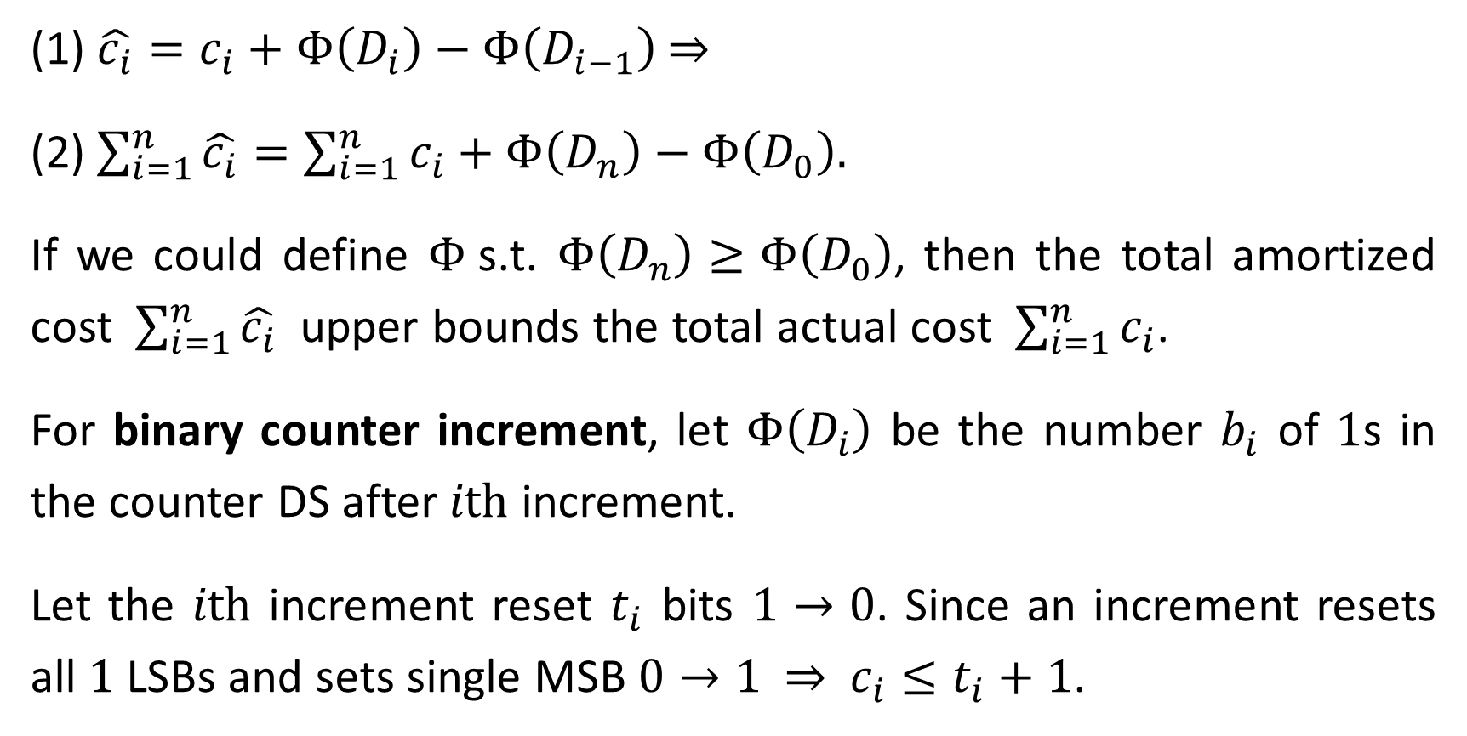
(1) $\hat{c_{i}}=c_{i}+Φ\left(D_{i}\right)−Φ\left(D_{i−1}\right)$ ⇒
(2) $\sum_{i=1}^{n}{\hat{c_{i}}}=\sum_{i=1}^{n}{c_{i}}+Φ\left(D_{n}\right)−Φ\left(D_{0}\right).$
If we could define $Φ$s.t. $Φ\left(D_{n}\right)≥Φ\left(D_{0}\right)$, then the total amortized cost $\sum_{i=1}^{n}{\hat{c_{i}}}$ upper bounds the total actual cost $\sum_{i=1}^{n}{c_{i}}$.
For binary counter increment, let $Φ\left(D_{i}\right)$ be the number $b_{i}$ of $1$s in the counter DS after $i\text{th}$ increment.
Let the $i\text{th}$ increment reset $t_{i}$ bits $1→0$. Since an increment resets all $1$ LSBs and sets single MSB $0→1$ ⇒ $c_{i}≤t_{i}+1$.

Slide 10
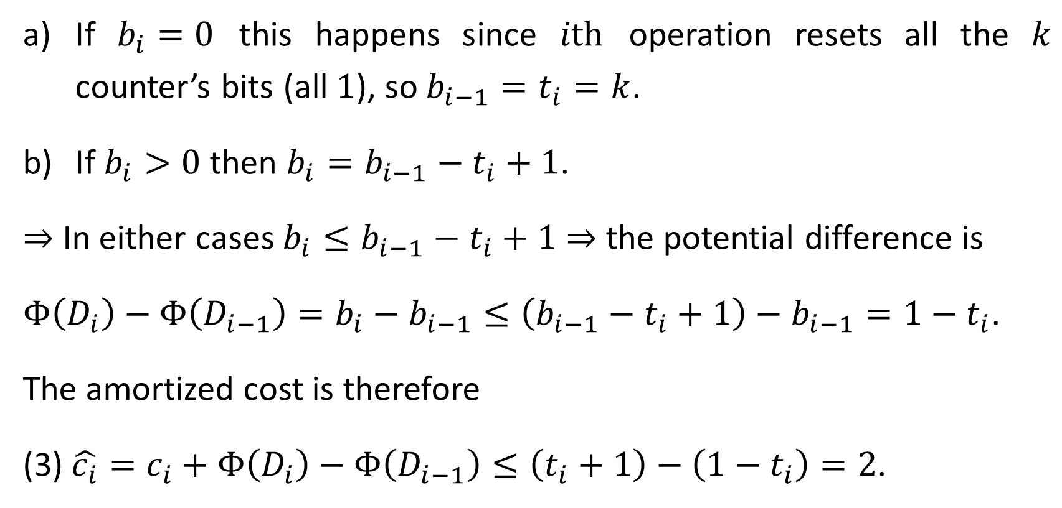
If $b_{i}=0$ this happens since $i\text{th}$ operation resets all the $k$ counter’s bits (all $1$), so $b_{i−1}=t_{i}=k$.
If $b_{i}>0$ then $b_{i}=b_{i−1}−t_{i}+1$.
⇒ In either cases $b_{i}≤b_{i−1}−t_{i}+1$ ⇒ the potential difference is
$Φ\left(D_{i}\right)−Φ\left(D_{i−1}\right)=b_{i}−b_{i−1}≤\left(b_{i−1}−t_{i}+1\right)−b_{i−1}=1−t_{i}$.
The amortized cost is therefore
(3) $\hat{c_{i}}=c_{i}+Φ\left(D_{i}\right)−Φ\left(D_{i−1}\right)≤\left(t_{i}+1\right)−\left(1−t_{i}\right)=2$.

Slide 11
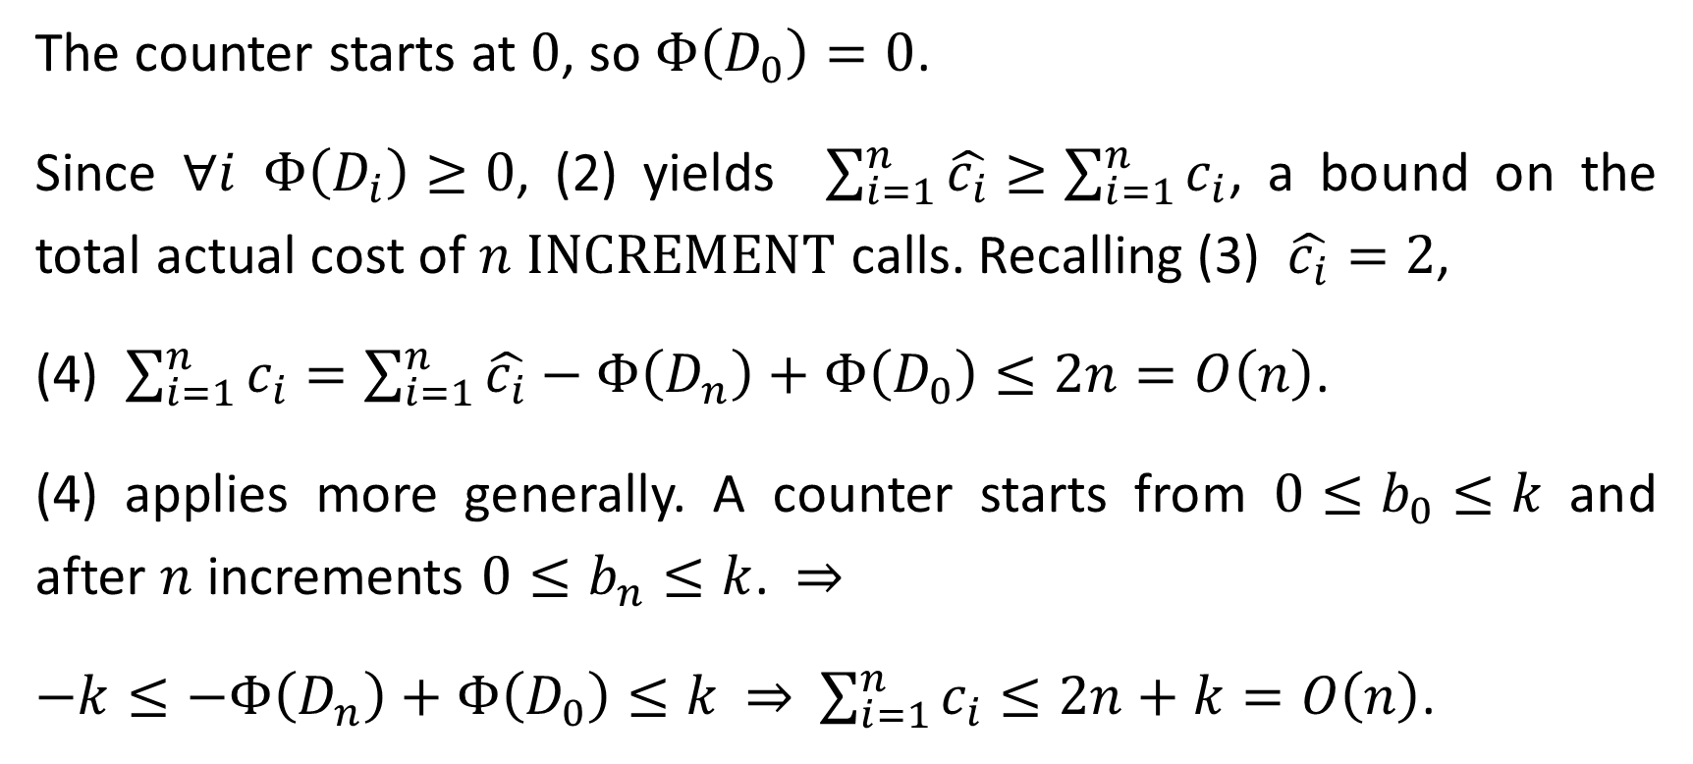
The counter starts at $0$, so $Φ\left(D_{0}\right)=0$.
Since $∀i$ $Φ\left(D_{i}\right)≥0$, (2) yields $\sum_{i=1}^{n}{\hat{c_{i}}}≥\sum_{i=1}^{n}{c_{i}}$, a bound on the total actual cost of $n$ $\text{INCREMENT}$ calls. Recalling (3) $\hat{c_{i}}=2$,
(4) $\sum_{i=1}^{n}{c_{i}}=\sum_{i=1}^{n}{\hat{c_{i}}}−Φ\left(D_{n}\right)+Φ\left(D_{0}\right)≤2n=O\left(n\right)$.
(4) applies more generally. A counter starts from $0≤b_{0}≤k$ and after $n$ increments $0≤b_{n}≤k$. ⇒
$−k≤−Φ\left(D_{n}\right)+Φ\left(D_{0}\right)≤k$ ⇒ $\sum_{i=1}^{n}{c_{i}}≤2n+k=O\left(n\right)$.

Slide 12
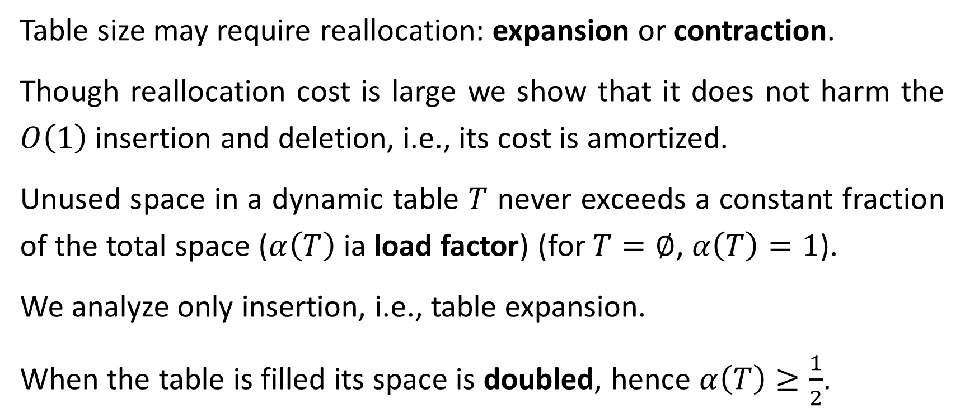
Dynamic Tables
Table size may require reallocation: expansion or contraction.
Though reallocation cost is large we show that it does not harm the $O\left(1\right)$ insertion and deletion, i.e., its cost is amortized.
Unused space in a dynamic table $T$ never exceeds a constant fraction of the total space ($α\left(T\right)$ ia load factor) (for $T=∅$, $α\left(T\right)=1$).
We analyze only insertion, i.e., table expansion.
When the table is filled its space is doubled, hence $α\left(T\right)≥\frac{1}{2}$.

Slide 13

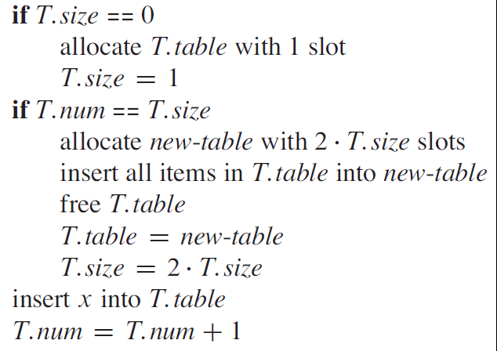
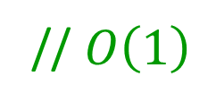
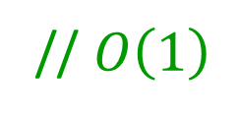

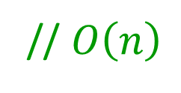
// initialization
// expansion
// $O\left(1\right)$
// $O\left(n\right)$
// $O\left(1\right)$
// $O\left(1\right)$

Slide 14
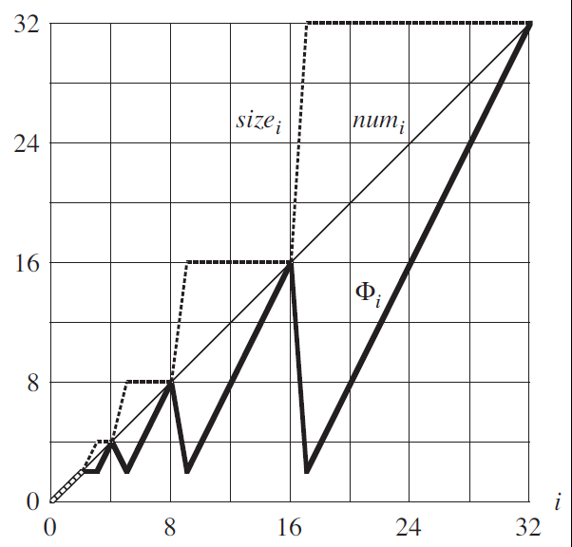


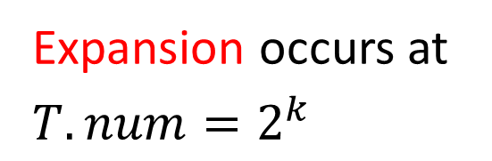



$$T.size$$
$$T.num$$
Expansion occurs at $T.num=2^{k}$
$$5$$
$$9$$
$$17$$

Slide 15
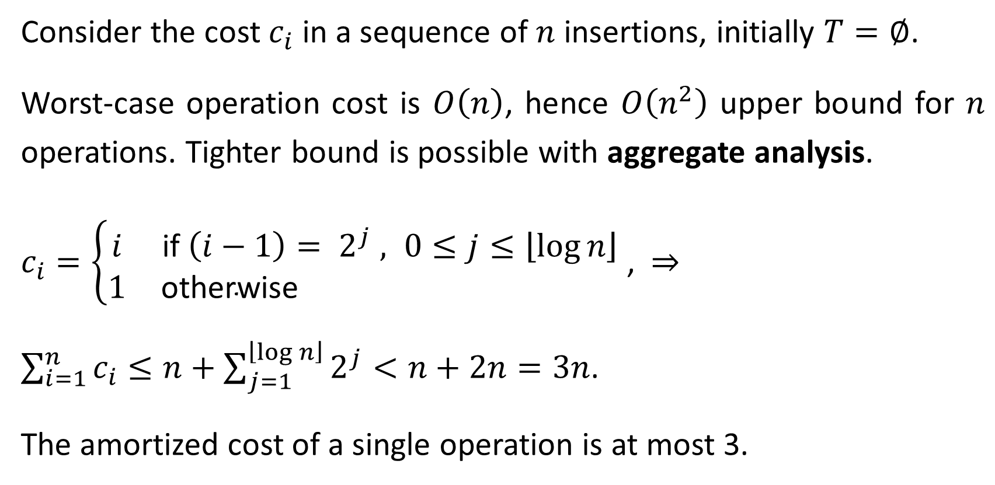
Consider the cost $c_{i}$ in a sequence of $n$ insertions, initially $T=∅$.
Worst-case operation cost is $O\left(n\right)$, hence $O\left(n^{2}\right)$ upper bound for $n$ operations. Tighter bound is possible with aggregate analysis.
$c_{i}=\left\{\begin{matrix}i & \text{if} \left(i−1\right)= 2^{j} , 0≤j≤\left\lfloor \log{n}\right\rfloor \\ 1 & \text{otherwise} \end{matrix}\right.$ , ⇒
$\sum_{i=1}^{n}{c_{i}}≤n+\sum_{j=1}^{\left\lfloor \log{n}\right\rfloor }{2^{j}}<n+2n=3n$.
The amortized cost of a single operation is at most 3.

Slide 16
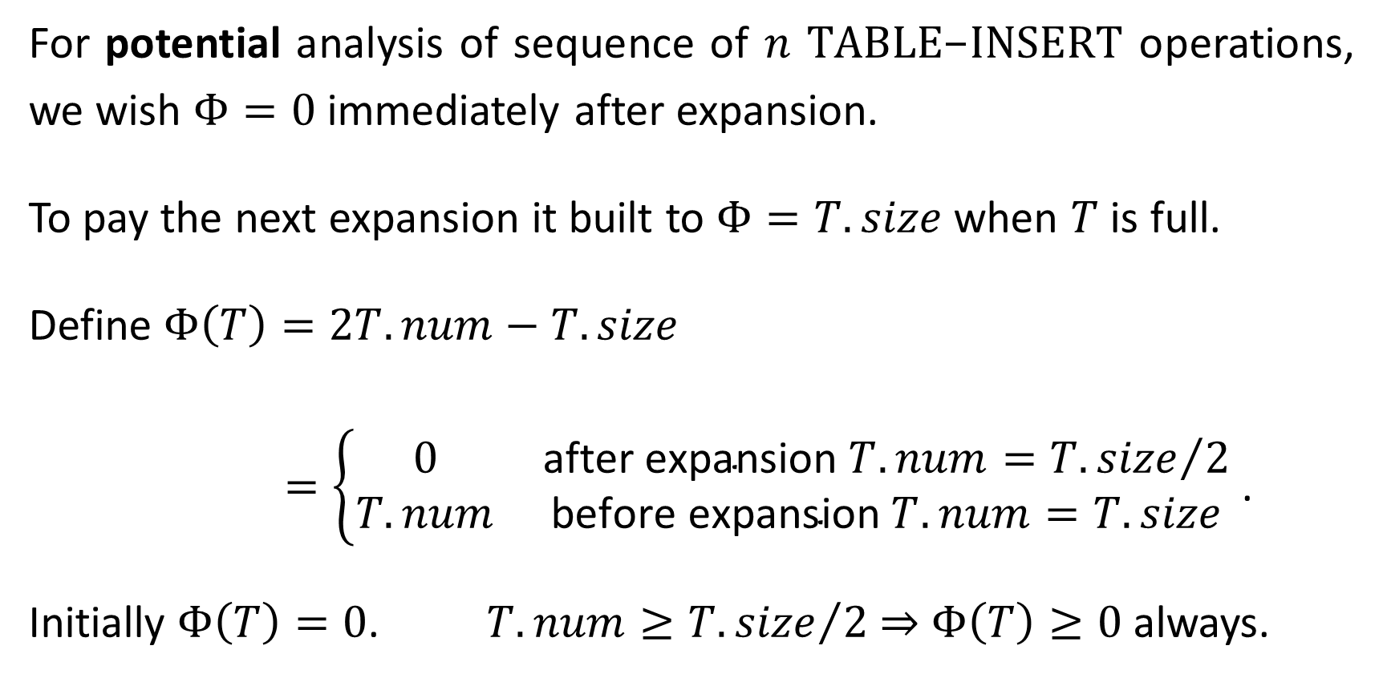
For potential analysis of sequence of $n$ $\text{TABLE}\text{−}\text{INSERT}$ operations, we wish $Φ=0$ immediately after expansion.
To pay the next expansion it built to $Φ=T.size$ when $T$ is full.
Define $Φ\left(T\right)=2T.num−T.size$
$=\left\{\begin{matrix}0 & \text{after} \text{expansion} T.num={T.size}/2 \\ T.num & \text{before} \text{expansion} T.num=T.size\end{matrix}\right.$ .
Initially $Φ\left(T\right)=0$. $T.num≥{T.size}/2$ ⇒ $Φ\left(T\right)≥0$ always.

Slide 17
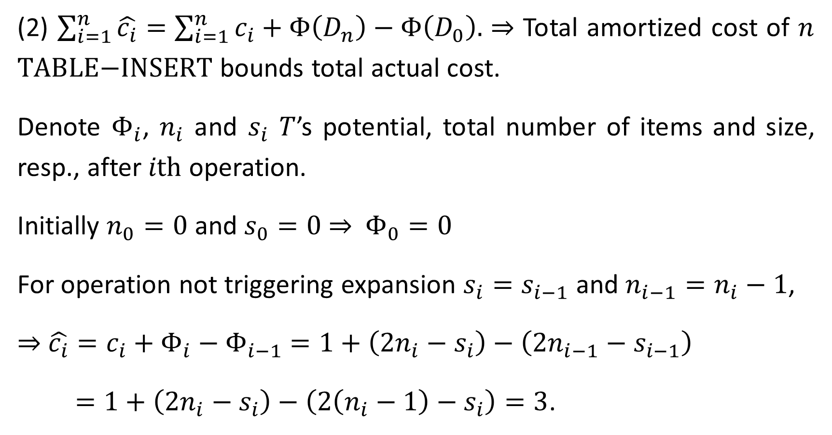
(2) $\sum_{i=1}^{n}{\hat{c_{i}}}=\sum_{i=1}^{n}{c_{i}}+Φ\left(D_{n}\right)−Φ\left(D_{0}\right).$ ⇒ Total amortized cost of $n$ $\text{TABLE}\text{−}\text{INSERT}$ bounds total actual cost.
Denote $Φ_{i}$, $n_{i}$ and $s_{i}$ $T$’s potential, total number of items and size, resp., after $i\text{th}$ operation.
Initially $n_{0}=0$ and $s_{0}=0$ ⇒ $Φ_{0}=0$
For operation not triggering expansion $s_{i}=s_{i−1}$ and $n_{i−1}=n_{i}−1$,
⇒ $\hat{c_{i}}=c_{i}+Φ_{i}−Φ_{i−1}$ $=1+\left(2n_{i}−s_{i}\right)−\left(2n_{i−1}−s_{i−1}\right)$
$=1+\left(2n_{i}−s_{i}\right)−\left(2\left(n_{i}−1\right)−s_{i}\right)=3$.

Slide 18
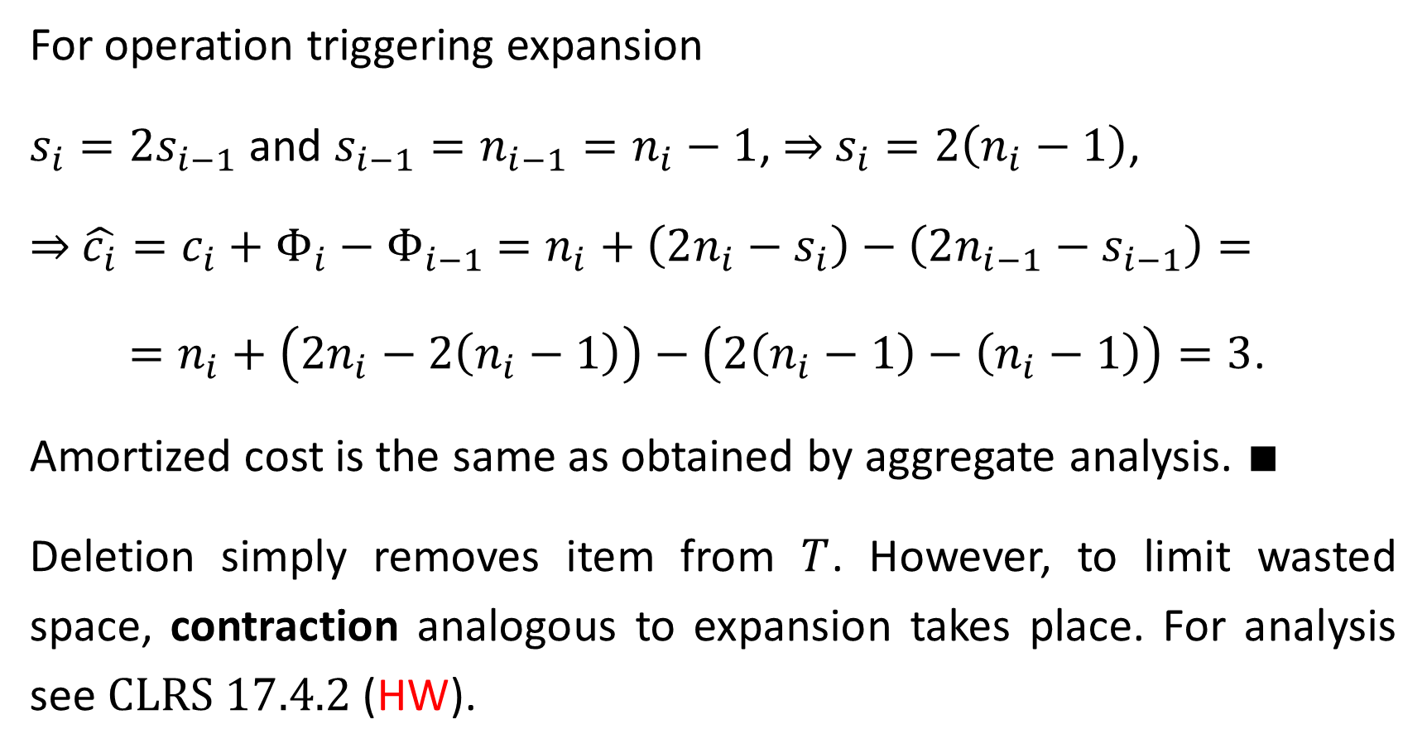
For operation triggering expansion
$s_{i}=2s_{i−1}$ and $s_{i−1}=n_{i−1}=n_{i}−1$, ⇒ $s_{i}=2\left(n_{i}−1\right)$,
⇒ $\hat{c_{i}}=c_{i}+Φ_{i}−Φ_{i−1}$ $=n_{i}+\left(2n_{i}−s_{i}\right)−\left(2n_{i−1}−s_{i−1}\right)=$
$=n_{i}+\left(2n_{i}−2\left(n_{i}−1\right)\right)−\left(2\left(n_{i}−1\right)−\left(n_{i}−1\right)\right)=3$.
Amortized cost is the same as obtained by aggregate analysis. ∎
Deletion simply removes item from $T$. However, to limit wasted space, contraction analogous to expansion takes place. For analysis see $\text{CLRS} 17.4.2$(HW).

